Slide 1
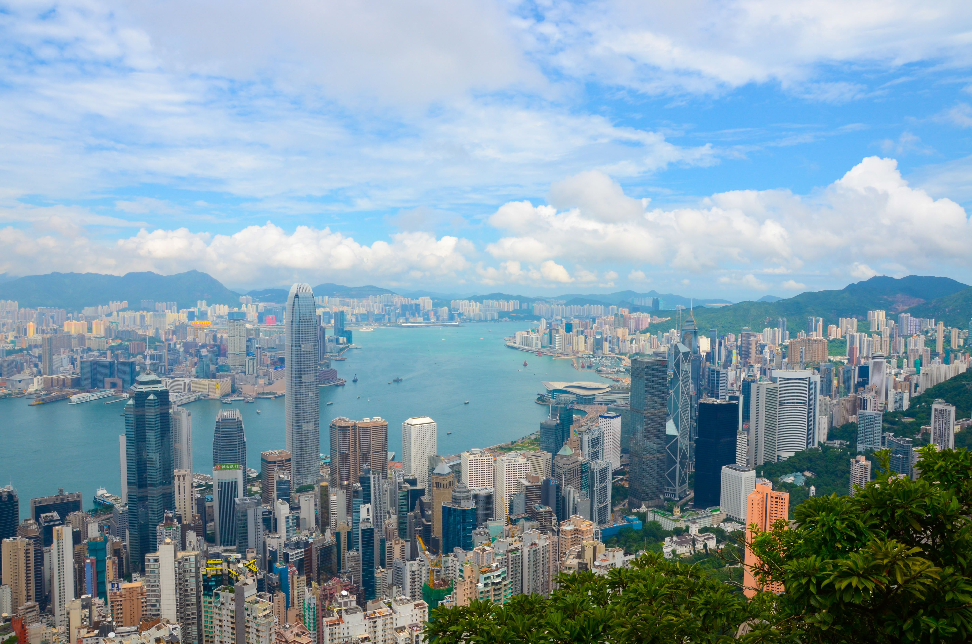


Slide 2
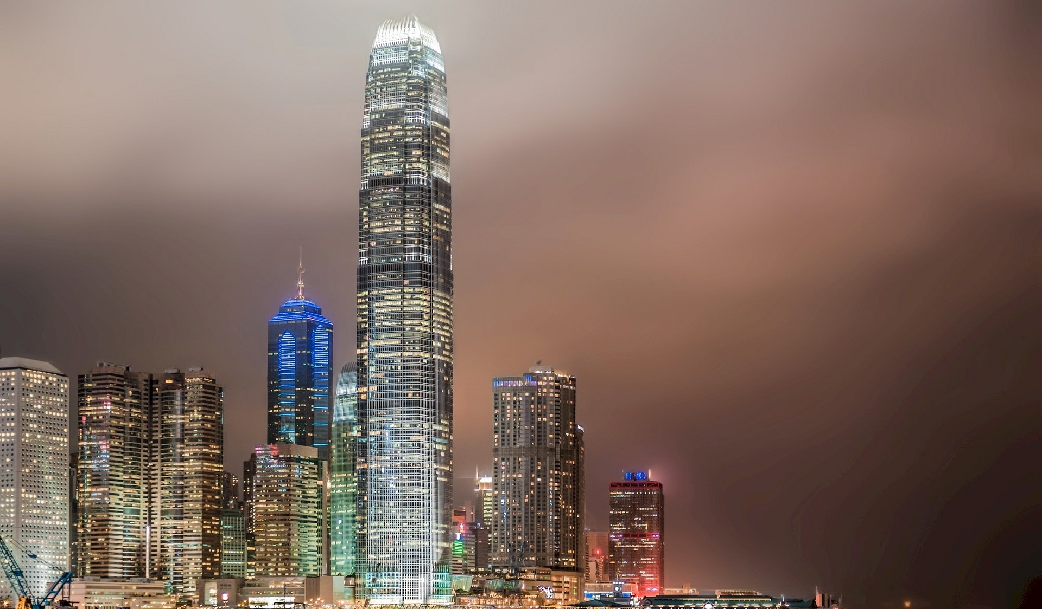
It is extremely hard to precisely pinpoint your location in Hong Kong

Slide 3




QR Codes
With an ID code
Smartphones
Intersections

Slide 4



Slide 5


Revenue
$1M
$5M

Slide 6
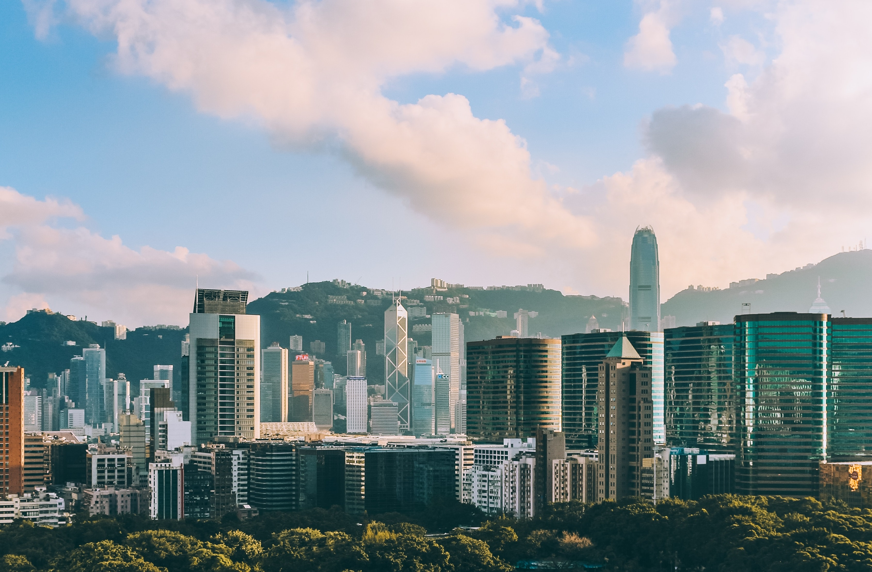
A better
future

